Slide 1
ENGAGING EMPATHY WITH ZINES AND MINI-COMICS
Stefanie Hilles
Arts and Humanities Librarian
Miami University
Sarah Nagle
Creation and Innovation Services Librarian
Miami University

Slide 2
Zines and Mini-Comics

Slide 3
What Are Zines and Mini-Comics
Zines: In his often-cited book, Notes from the Underground: Zines and the Politics of Alternative Culture, Stephen Duncombe defines zines as noncommercial, nonprofessional, small circulation, self-published magazines that are not created to turn a profit. They are associated with counter cultures and marginalized peoples, handmade - often with a DIY or collage aesthetic - and use both text and image to make meaning. Both text and images can either be original, as in created by the author or artist, or appropriated from another source, as in the case of collage.
Mini-Comics: Although there is no standard definition of a mini-comic, the term generally refers to hand-made, independently-published comics. They do not have to be a certain size to be considered mini-comics. As opposed to zines, mini-comics usually use a narrative cartoon format.

Slide 4
Zines/Mini-comics and Empathy

Slide 5
Why are Zines/Comics Effective tools for empathy?
Although zines and comics have been around for many years, the power that these tools hold for fostering empathy.
Caldwell (2022) - interacting with stories of trans folks through comics/zines can encourage empathy and educate others about transgender individuals and their experiences.
Leteurtre, Scott, & Swaby (2023) - highlight the potential of zines as an anti-stigma intervention for people with chronic pain.

Slide 6
Visual Thinking Strategies (VTS)

Slide 7
Visual Thinking Strategies
Started at MOMA
Key Question: What happens cognitively when someone looks at a work of art?
Findings: 5 stages of aesthetic development
Accountive
Constructive
Classifying
Interpretive
Recreative

Slide 8
Visual Thinking Strategies
Critical
Thinking
Sense of Self as Part of a Community
Social and Emotional Development
Aesthetic
Development
Sense of Self as Learner
Language
Development

Slide 9
Visual Thinking Strategies
Goals
Critical thinking – make observations, reasons have evidence, speculate, evaluate and revise ideas
Communication and collaboration – speaking and listening skills, confidence in being able to express oneself
Visual literacy – analyze and find meaning in works of art, develop a personal connection to art
Mindset – intellectual curiosity, perseverance, and openness to the unfamiliar

Slide 10
Visual Thinking Strategies
Basic Steps
Present artwork to students and allow a few moments for silent looking
Pose three specific questions
What’s going on in this picture?
What do you see that makes you say that?
What more can we find?
Facilitate open ended discussion

Slide 11
Visual Thinking Strategies
Facilitate Discussion By
Listening carefully to what the student says
Point to their observations as they comment
Paraphrase each comment using conditional language
Link related comments whether they agree or disagree, or build on another student’s ideas
Remain neutral, treating every comment in the same way
Conclude by thanking students for participating

Slide 12
Zines/Mini-Comics And Visual Thinking Strategies

Slide 13
Why VTS for zines?
Brown et al. (2021) - Zines for dialogue, reflection, and learner empowerment - born out of counter-cultural movements and self-expression.
VTS enables students to:
Look carefully
Engage in thoughtful discussion on what they see
Back up their ideas with evidence
Listen to and consider the views of others, agreeing, disagreeing, or building on what they hear
See that a variety of interpretations are possible
We can combine these two pedagogical super tools!

Slide 14
Empathy And Visual Thinking Strategies

Slide 15

VTS and Empathy
Sinquefield-Kangas (2019) - workshop participants discussed image from Shaun Tan’s The Arrival.
VTS exercises elicited empathic discourse
VTS as a pedagogical tool can be impactful for eliciting empathy in students
Think about outcomes of VTS (& how they could connect w/ empathy)
Social and emotional development
Sense of self as part of the community
VTS is often used in medicine and medical education - both for medical providers and patients.

Slide 16
Lesson Plan

Slide 17
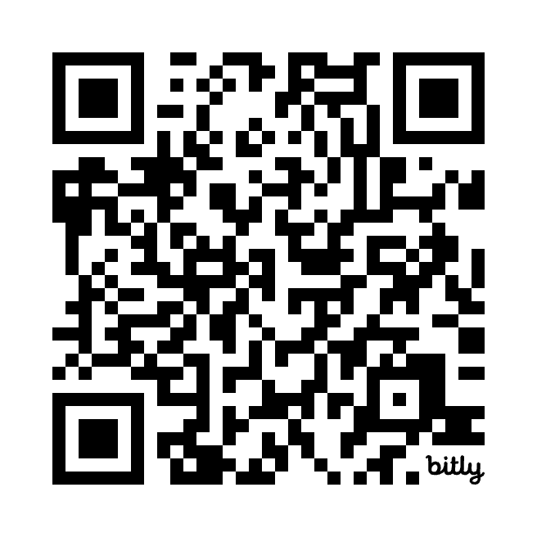
Lesson Plan
Part 1 - Instructor defines zines
Part 2 - Think/Pair/Share
Introduce questions to students
What’s going on in this zine?
What do you see that makes you say that?
What more can you find?
Think: Individually, students look at an online zine (5 mins)
Pair: Students discuss questions at their table in their groups (5 mins)
Share: Instructor leads open-ended discussion based on above questions (10 mins)
Students complete two think/pair/share sessions, each with a different zine
Part 3 - Students make zines based on one of the think/pair/share examples

Slide 18
Learning Outcomes
At the end of this lesson, students will:
Understand what zines are and how they function to record and promote counter-cultural voices as well as challenge traditional authority
Analyze how text and image can work together to create meaning
Classify and interpret graphic medicine using VTS strategies
Recreate/reinterpret their own original zines based on analysis of source material

Slide 19
Student Examples

Slide 20
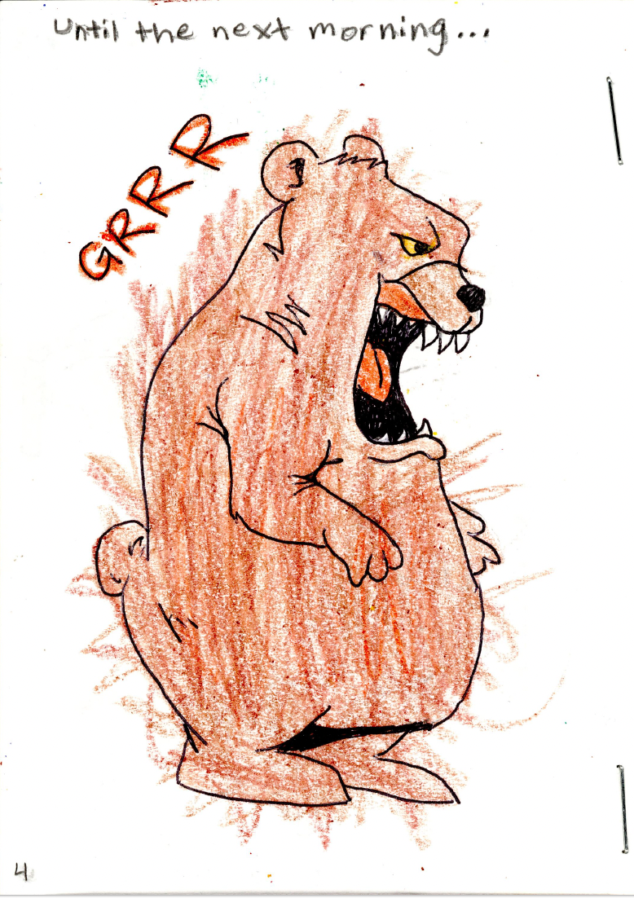
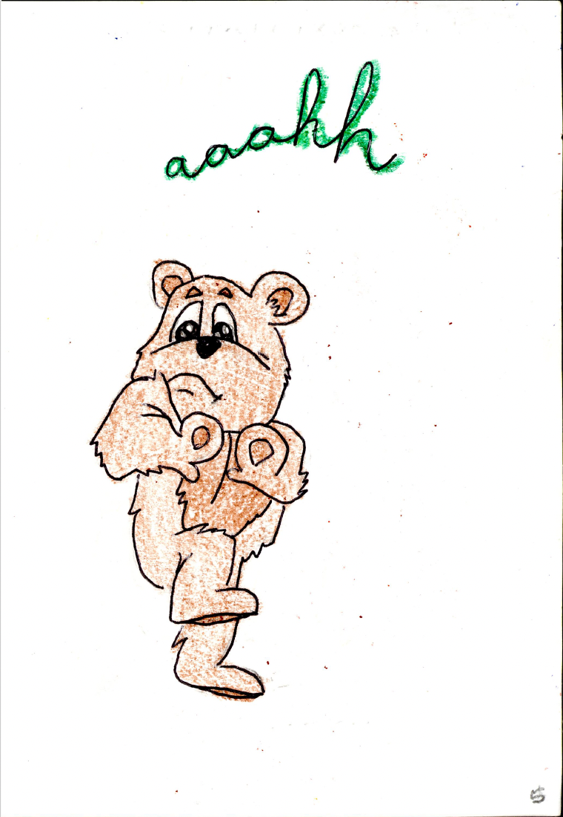
The (Un)friendly Beasts
Kaitlin Deniham
Annie Morman
Chloe Wheeler
Sofiya Kryroruchenko
2019

Slide 21
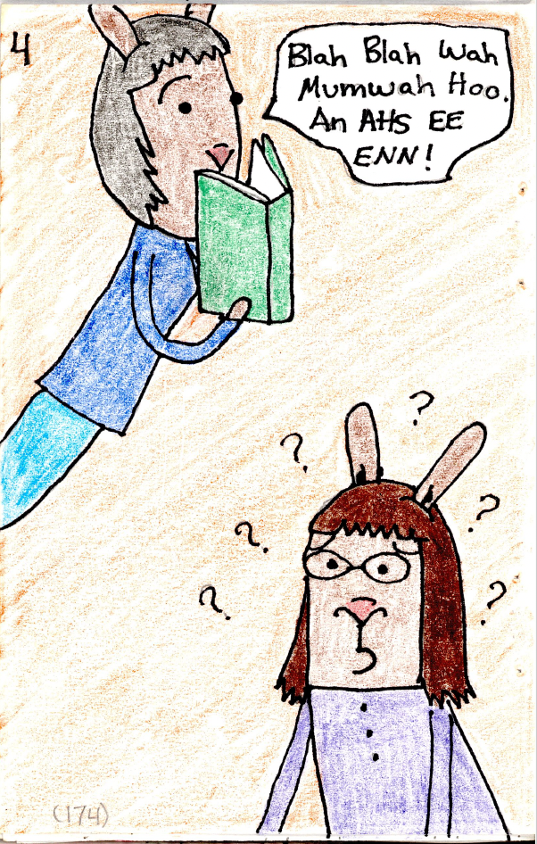
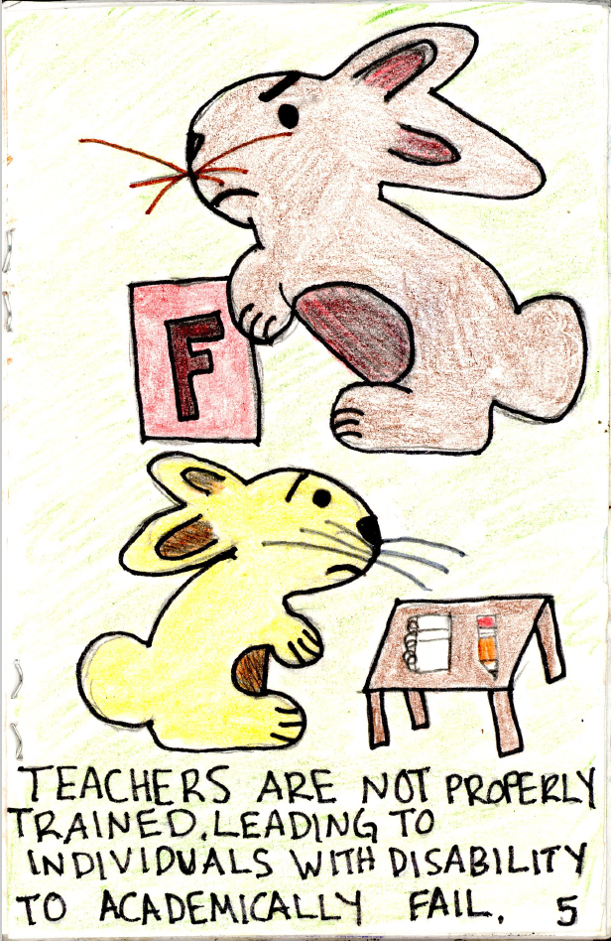
Education: Turning Impairment into Disability
Dalton Eversole
Alyson McElhinny
Elle Campbell
2019

Slide 22
Bibliography
Brown, A., Hurley, M., Perry, S., & Roche, J. (2021). Zines as Reflective Evaluation Within Interdisciplinary Learning Programmes. Frontiers in Education, 6. https://doi.org/10.3389/feduc.2021.675329
Caldwell, Carly, "Exploring Challenges and Triumphs within the Transgender Community through Comics-Based Research" (2022). Art Therapy Counseling Final Research Projects. 9. https://spark.siue.edu/atcfinal/9
Duncombe, S. (2017). Notes from underground : zines and the politics of alternative culture. Microcosm Publishing.
Ferrara, V., D’Egidio, V., Miceli, F., La Torre, G., & Consorti, F. (2018). Visual Thinking Strategies (VTS) and art production to improve training and prevent burnout among training and prevent burnout among healthcare students: protocol of a field trial. Senses and Sciences, 5(4), 635-640, DOI:10.14616/sands-2018-5-635640
Gara, C. (Summer, 2023). Cultivating Empathy – and a Sense of Wonder. Johns Hopkins University. https://www.hopkinscim.org/breakthrough/summer-2023/cultivating-empathy-and-a-sense-of-wonder/
Leteurtre, C., Scott, W, & Swaby, C. (2023). A case report of Patient and Public Involvement and Engagement activities to explore the potential of zines as an arts-based tool to target the stigma of pain. Pain and Rehabilitation, 53(1), 22 - 29.
Sinquefield-Kangas, R. (2019). Looking for Empathy in Visual Encounters. International Journal of Education & the Arts, 20(21). http://www.ijea.org/v20n21/
Yenawine, P. (2013). Visual thinking strategies : using art to deepen learning across school disciplines. Harvard Education Press.

Slide 23
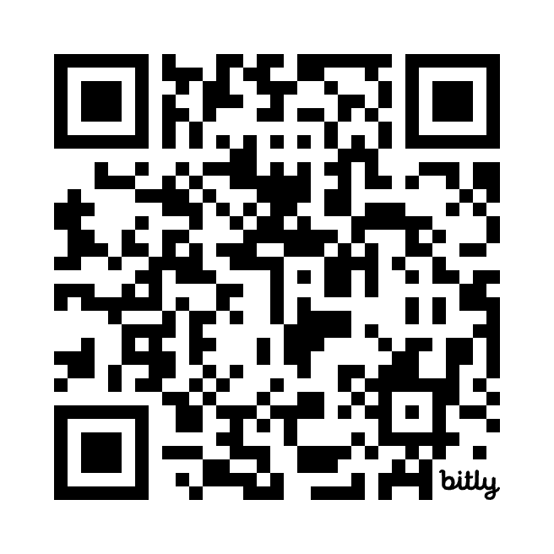
Thank you!
Questions?
Slides & Lesson Plan
Stefanie Hilles
Arts and Humanities Librarian
Miami University
Sarah Nagle
Creation and Innovation Services Librarian
Miami University

